Slide 1
LWA SEE PROGRAM PROFESSIONAL DEVELOPMENT WORKSHOP 2017
LWA is a contracted supplier of assessment validation services, moderation workshops and professional development services under the Skills for Education and Employment Program funded by the Department of Education and Training

Slide 2
AGENDA
8.30 – 9.00 | Registration, on arrival tea and coffee
9.00 – 9.10 | Welcome, introductions, overview and purpose of the day
9.10 – 9.30 | Task Design and Cycle of Task Design
9.30 – 10:40 | SESSION 1: IPA LOA READING MODERATION
10:40 – 11:00 | SESSION 2: ORAL COMMUNICATION LISTENING ACTIVITY
11:00– 11:15 | Morning Tea
11:15 – 11:40 | SESSION 2: ORAL COMMUNICATION SPEAKING ACTIVITY AND TASK MODERATION
11.15 – 12.50 | SESSION 3: IPA LOA WRITING MODERATION
12.50 – 1.30 | Lunch
1.30 – 2.45 | SESSION 4: DIGITAL TECHNOLOGY TASK ACTIVITY
2.45 – 3.00 | Afternoon tea
3.00 – 3.45 | SESSION 5: LOCAL ISSUES DISCUSSION
3.45 – 4.00 | Wrap up and evaluation forms

Slide 3
Purpose of the Day
Consistency in interpretation and application of the ACSF
Build on professional knowledge
Support teaching and assessment practices
Discuss local issues

Slide 4
Designing Your SEE Program Task
Determine ACSF level Refer to Performance Variables Grid
Select appropriate text or stimulus for task
and contextualise to local area
Create task questions for student
Create assessor guide
Create task instructions for student
Create task instructions for assessor

Slide 5
Task Moderation / Trial Cycle
Step #1
#1: Design Task
#2: Moderate Task with Colleagues
#3: Modify Task based on Colleagues Feedback
#4: Trial Task with Students
#5: Modify Task based on Student Responses
Step #3
DESIGN TASK / MODIFY TASK
Step #2
Step #5
Step #4
MODERATE TASK
TRIAL TASK

Slide 6
WHEN MODERATING TODAY:
Tasks and client responses stand alone
Align material against ACSF considering:
Indicator Descriptor
Performance Variables Grid
Performance Features
Sample Activities
Review all elements of Task: text, instructions, questions, answers
Consider client cohort targeted: EAL, ESB, ATSI

Slide 7
SESSION ONE
READING MODERATION

Slide 8
SESSION 1: READING MODERATION
FOLDERS: R1 – R7, ACSF LEVEL 1 – 4: LIGHT PINK COVER SHEETS
Is the allocated ACSF core skill and level accurate?
Is the task sufficient to support the indicator?
Does the client response demonstrate the indicator?
Would you adapt this task to use in your own context? How?

Slide 9
SESSION ONE, COMMENTARY R1
TASK: ANH DO’S LIFE STORY ACSF 1.04
Task: Aligned
Appropriate and current content
Good model text for a range of client cohorts
Good ‘running record’ in task design for reporting against 1.04
Client Sample: Demonstrated
Client specific evidence referenced

Slide 10
SESSION ONE, COMMENTARY R2
TASK: DON’T PHONE & DRIVE ACSF 1.03, 1.04
Task Not Aligned
Contemporary topic, relevant across cohorts
Text complexity exceeds ACSF Level 1 e.g. sentence complexity, abbreviation
Task complexity exceeds ACSF Level 1 e.g. Q7
Simplify task for ACSF Level 1 use

Slide 11
SESSION ONE, COMMENTARY R3
TASK: FINDING A JOB IN RURAL QLD ACSF 2.03, 2.04
Task: Not Aligned
Appropriate text for regional/remote communities
Text complexity exceeds ACSF Level 2 e.g. vocabulary, grammar
Task complexity exceeds ACSF Level 2 e.g. Q6, Q8, Q10, Q19
Simplify task for ACSF Level 2 use or apply to ACSF Level 3 with appropriate questions
Client Sample: Demonstrated
Client has completed questions well which suggests they are operating in Level 3

Slide 12
SESSION ONE, COMMENTARY R4
TASK 1: JACQUES PLANTATION ACSF 2.04
Task: Not Aligned
Highly contextualised task for learner
Client-specific context explanation makes topic familiar for ACSF Level 2 Performance Variables Grid
Text complexity exceeds ACSF Level 2. Modify text to more closely align with ACSF Level 2 Performance Features
Client Sample: Demonstrated
Good assessor annotations on the task
Limited client specific examples given in assessor analysis

Slide 13
SESSION ONE, COMMENTARY R4
TASK 2: LENTIL DAHL RECIPE ACSF 2.04
Task: Aligned
Level 2 sample activity
Well contextualised to student’s work experience in kitchen
Client Sample: Demonstrated
Good assessor annotations on the task, e.g. decoding and fluency
Comprehensive assessor analysis

Slide 14
SESSION ONE, COMMENTARY R5
TASK: SHARK NETS ACSF 3.03, 3.04
Task: Aligned
Online news story appropriate for Level 3
Anti-shark net poster complements news story well
Assessor scribed for student at Level 3 questionable practice
Client Sample: Not Demonstrated
Some answers suggest student is not operating at exit Level 3 e.g. Q6, Q7, Q12, Q13.

Slide 15
SESSION ONE, COMMENTARY R6
TASK: TICKETEK ACSF 3.03, 3.04
Task: Not Aligned
Good use of digital technology in task design
Range of potential events client could read; difficult to ensure Level 3 Reading
Questions ‘What is the event?’ ‘Where is the event’ lack complexity and will not elicit Level 3 Performance Features
Task better adapted to Level 2 / Level 3 Numeracy: choose an event and budget for your family

Slide 16
SESSION ONE, COMMENTARY R7
TASK: THE SHARING ECONOMY ACSF 4.04
Task: Aligned
Suite of texts well align to level
Different views (pro, anti, neutral) explore theme of ‘the sharing economy)
Includes picture, graph, cartoon
Questions align e.g. asking about metaphor (Q9), contrasting ideas (Q13), comparing the stories (Q17, Q18)
Client Sample: Demonstrated
Client answers questions comprehensively
Able to analyse different perspectives as well as provide own opinion

Slide 17
SESSION TWO
ORAL COMMUNICATION LISTENING ACTIVITY AND TASK MODERATION

Slide 18
TASK: Home Fire Safety
Listen to the audio and answer:
What ACSF Level is the listening?
Note examples to support your answer.
Video

Slide 19
SESSION TWO, LISTENING ACTIVITY
HOME FIRE SAFETY ACSF 2.08
Good use of relevant, authentic text using technology
Visuals support language, repetition of key points, pace of speech at Level 2
Authentic listening task

Slide 20
SESSION 2: ORAL COMMUNICATION TASK MODERATION
Home Fire Safety Task: Speaking / Listening
Is the allocated ACSF core skill and level accurate?
Is the task sufficient to support the indicator?
Does the client response demonstrate the indicator?
Would you adapt this task to use in your own context? How?

Slide 21
SESSION TWO, COMMENTARY OC
TASK: HOME FIRE SAFETY ACSF 2.07
Task: Not Aligned
May not elicit evidence at exit 2.07
Task limited as designed
Client Sample: Not Demonstrated
Task contextualised around the fire safety theme
Task links to student’s own knowledge and experience, and ideas, events and information
Evidence presented phrases and simple sentence structures with irregular grammar

Slide 22
SESSION TWO, COMMENTARY OC
TASK: HOME FIRE SAFETY ACSF 2.08
Task: Aligned
Several steps in task instructions could be confusing/increases complexity
Client Sample: 2.08 Demonstrated
Transcript presented to support evidence
Evidence of specific listening reported in assessor analysis using quotes
Watching ‘as many times as you need’ may not suggest exit competence

Slide 23
SESSION TWO
ORAL COMMUNICATION SPEAKING ACTIVITY

Slide 24
TASK: Visiting the Doctor
Listen to the audio and answer:
What ACSF level is the speaking?
Note examples to support your answer.
Audio

Slide 25
SESSION TWO, SPEAKING ACTIVITY
VISITING THE DOCTOR ACSF 1.07
Client Sample: 1.07 Demonstrated
Evidence largely presented as isolated words or phrases
Sympathetic interlocutor
Number of closed questions; limited opportunities to expand

Slide 26
SESSION 2: ORAL COMMUNICATION TASK MODERATION
Visiting The Doctor: Listening
Is the allocated ACSF core skill and level accurate?
Is the task sufficient to support the indicator?
Does the client response demonstrate the indicator?
Would you adapt this task to use in your own context? How?

Slide 27
SESSION TWO, COMMENTARY OC
TASK: VISITING THE DOCTOR ACSF 2.08
Task: Aligned
Clear task instructions
Context given but could be strengthened with classroom activities
Complexity of scenario is Level 2
Able to respond to statement of 1 or more clauses
Understands vocabulary related to most aspects of everyday life
Understood non-verbal communication e.g. intonation

Slide 28
SESSION TWO, COMMENTARY OC
TASK: VISITING THE DOCTOR ACSF 2.08
Client Sample: 2.08 Demonstrated
Active listening task appropriate complexity for 2.08
Transcript presented to support evidence
Evidence of specific listening reported in assessor analysis using quotes

Slide 29
SESSION THREE
WRITING MODERATION

Slide 30
SESSION 3: WRITING MODERATION
FOLDERS: W1 – W6, ACSF LEVEL 1 – 3: LIGHT BLUE COVER SHEETS
Is the allocated ACSF core skill and level accurate?
Is the task sufficient to support the indicator?
Does the client response demonstrate the indicator?
Would you adapt this task to use in your own context? How?

Slide 31
SESSION THREE, COMMENTARY W1
TASK 1: YOUR DETAILS ACSF 1.05
Task 1: Aligned
Different types of forms demonstrated
Client Sample: Demonstrated
Demonstration of filling different forms exit competence

Slide 32
SESSION THREE, COMMENTARY W1
TASK 2: NOTICES ACSF 1.05
Task 2: Not Aligned
Task directions may encourage copying
Task instructions serve as model
Recommend modifying
Client Sample: Not Demonstrated
Reliance on directions/instructions evident

Slide 33
SESSION THREE, COMMENTARY W2
TASK: HOW DO YOU GET TO TAFE ACSF 1.06
Task: Not Aligned
Highly familiar context
Questions serve as scaffolding
A good teaching task
Client Sample: Not Demonstrated
Use of questions prompts evidence in writing

Slide 34
SESSION THREE, COMMENTARY W3
TASK 1: EMAIL TO CHILDCARE ACSF 2.05
Task: Aligned
Authentic task for level tailored to student
Instructions clear; task scenario could serve as model text
Good evidence of drafting process
Simple planning section would strengthen task
Sending an email would strengthen the task
Client Sample: Demonstrated
Client has followed instructions
Good assessor notes captured on task
2 clause sentences

Slide 35
SESSION THREE, COMMENTARY W3
TASK 2: JOB APPLICATION AND LETTER ACSF 2.05
Task: Aligned
Authentic online application form
Client Sample: Demonstrated
Good practice using an online form
Exit competence demonstrated in completion of form
Student produces well written cover letter with emerging Level 3 features

Slide 36
SESSION THREE, COMMENTARY W4
TASK: A SURVEY ACSF 2.06
Task: Aligned
Opinion on subject of relevance to student
Survey form supports the planning process with prompts
Client Sample: Demonstrated
Strong client performance
Vocabulary/grammar appropriate to level

Slide 37
SESSION THREE, COMMENTARY W5
TASK: JOB APPLICATION ACSF 3.05, 3.06
Task: Aligned
Aligns to sample activities
Appears to be genuine job application e.g. seek.com.au
Provides opportunity for a variety of writing styles e.g. bullet points
Complex vocabulary related to job roles & job search
Step 3 of task not aligned to Level 3 complexity
Client Sample: Not Demonstrated
Assessor analysis not linked to client demonstrated evidence
Plan, draft, proof, review not explained by assessor in analysis e.g. changes in punctuation
Control of informal versus formal language not clearly demonstrated
Assessor analysis not linked to client demonstrated evidence

Slide 38
SESSION THREE, COMMENTARY W6
TASK 1: RESUME WRITING ACSF 3.05, 3.06
Task: Aligned
Level 3 sample activity
Instructions are clear and appropriate for ACSF Level 3 Performance Variables Grid e.g. independently sourced models for resume
Drafting process well-supported in task design
Client Sample: Demonstrated
Student has completed their resume appropriately
Client-specific detailed assessor analysis
Appropriate correction code for the ACSF level

Slide 39
SESSION THREE, COMMENTARY W6
TASK 2: LETTER OF COMPLAINT ACSF 3.05, 3.06
Task: Aligned
Task design appropriate to elicit 3.05 performance features.
Task design allows for demonstration of some specialised vocabulary and complex sentences
Client Sample: Demonstrated
Use of correction code appropriate for Level 3 evident
Good recognition of audience and purpose e.g. word choice
Appropriate level of formality e.g. formal letter layout, vocabulary

Slide 40
SESSION FOUR
DIGITAL TECHNOLOGY RESOURCE AND TASK ACTIVITY

Slide 41
Digital Technology Resource
PURPOSE
To build and strengthen on existing teachers’ / assessors’ skills and knowledge in use of digital technology
Inspire teachers and assessors with new ideas
Increase use of digital technology in teaching and assessment
To engage students in digital technology beyond the personal and social domain
Types of Technology
Smart Phones
Tablets
Personal Computer/Laptops

Slide 42
DIGITAL TECHNOLOGY RESOURCE
Total of 19 ‘How To Guides’
‘How To Guide’ is a PD tool for teachers/assessors
Four Basics to Get You Started: the underpinning skills
15 ‘How To Guides’ demonstrating range of applications
A Glossary of Terms
10 ACSF Aligned Assessment Tasks
Showing application of 10 ‘How To Guides’ in ACSF aligned assessment tasks
NB: Digital Technology is a fluid environment; please view Resource in this context

Slide 43
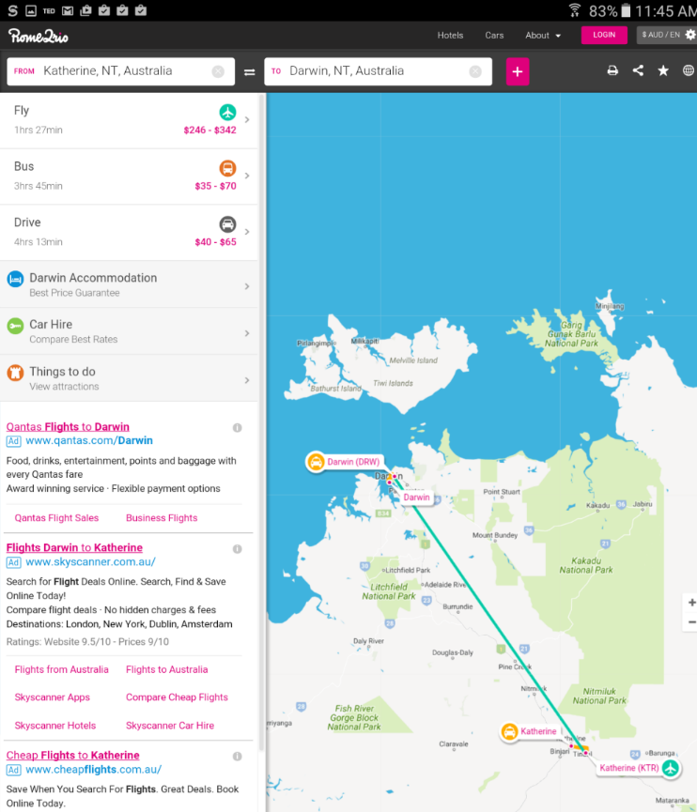
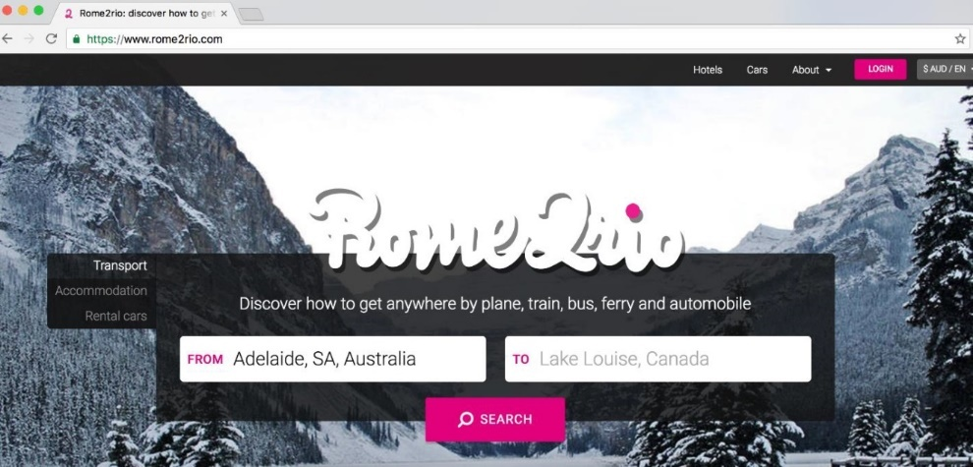
Examples of Content
Journey Planner Apps

Slide 44
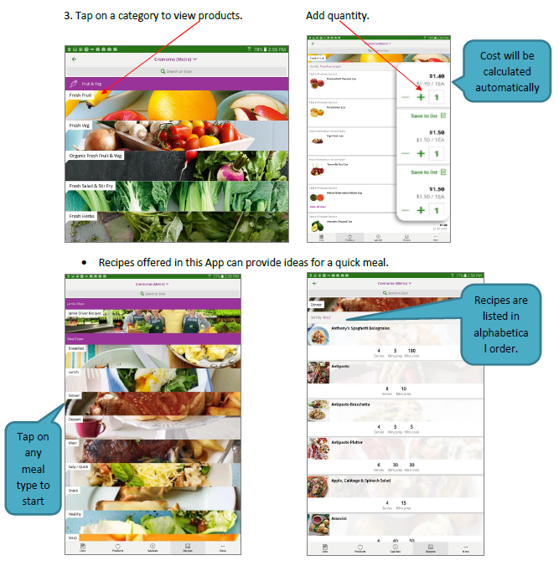
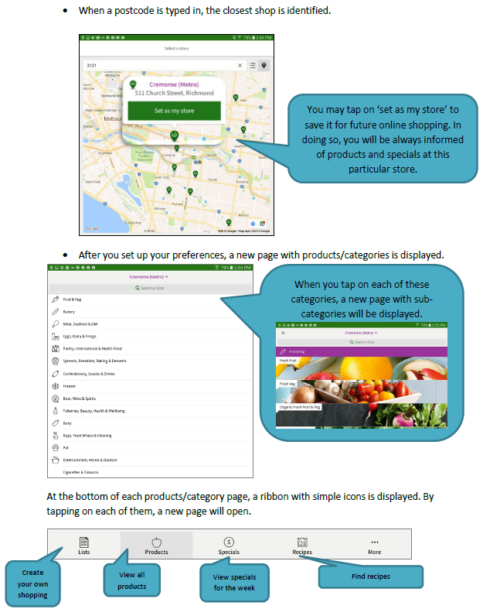
Online Shopping

Slide 45
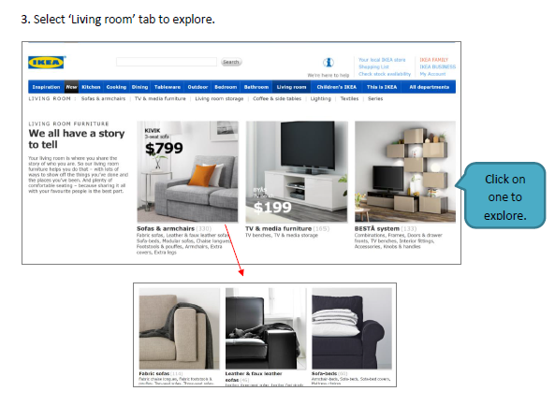

Slide 46
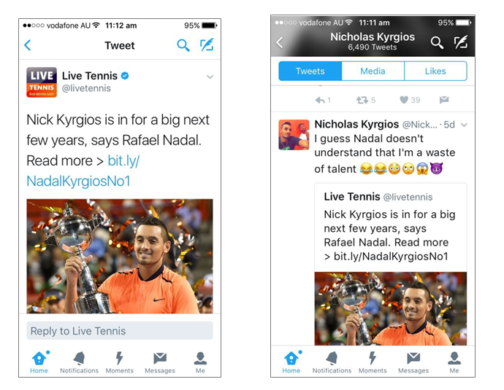
Using Twitter

Slide 47
Digital Technology Task Activity
Activity A: Write and Screenshot a text message
OR
Activity B: Use Google Forms to create an online writing assessment task
ACSF Level 1 : Library Application Form
ACSF Level 2 : Wood End Community Centre Application Form
ACSF Level 3 : Time Off Request

Slide 48
‘How to Guide’ – Take a screenshot

Slide 49
‘How to Guide’ – Take a screenshot

Slide 50
‘How to Guide’ – Google Forms

Slide 51
‘How to Guide’ – Google Forms

Slide 52
‘How to Guide’ – Google Forms

Slide 53
‘How to Guide’ – Google Forms

Slide 54
‘How to Guide’ – Google Forms

Slide 55
‘How to Guide’ – Google Forms

Slide 56
Handouts
Laminated set of ‘How To Guide’ to familiarise yourself
An LWA tablet
Activity A: Written task for you to follow
Activity B: Three written tasks for you to follow.
Select according to your level of confidence.

Slide 57
Digital Access
Please log-on to Wi-Fi. Log-on instructions will be given.
If using the LWA tablet, you are already logged in with a Gmail account.
If using your own tablet/ipad or laptop, please use your own personal/work email.

Slide 58
SESSION FIVE
LOCAL ISSUES DISCUSSION

Slide 59
PLEASE FILL IN YOUR EVALUATION FORM
Contact us:
T: 03 9429 7551 F: 03 9429 7221 www.lwa.net.au
Office admin: juliana@lwa.net.au SEE admin: see@lwa.net.au
Verification:
Directors and verifiers: fiona@lwa.net.au mary@lwa.net.au
Verifiers:
suzana@lwa.net.au julie@lwa.net.au sandya@lwa.net.au
dina@lwa.net.au prue@lwa.net.au charlie@lwa.net.au
anna@lwa.net.au

